Slide 1
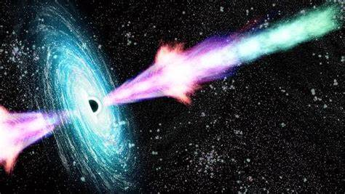
16th March 2023, Konkoly Observatory, Budapest
Deciphering the ~18 TeV photons from
GRB 221009A
Sarira Sahu
ICN, UNAM, Mexico City
Collaborators
B. Medina-Carrillo, G. Sánchez-Colón, Subhash Rajpoot
ApJL 942, L30 (2023)
Notes:
Prof. László Molnár

Slide 2
Introduction
Observation of Gamma Ray Bursts (GRBs) in very high energy (VHE > 100 GeV)
What are the most used models to explein these events
Photohadronic model
Observation of some GRBs in VHE
GRB 221009A
Summary

Slide 3
Energy resease/sec
Sun 10³³
Nova 10³⁹
Supernova 10⁴¹
Gamma-Ray Burst
Energy release: 10⁵¹ - 10⁵⁵ erg
Time duratio ~ Few seconds
Event Rate ~ 1-2 events/day
For a brief moment, gamma-ray bursts outshine the entire gamma- ray universe.

Slide 4
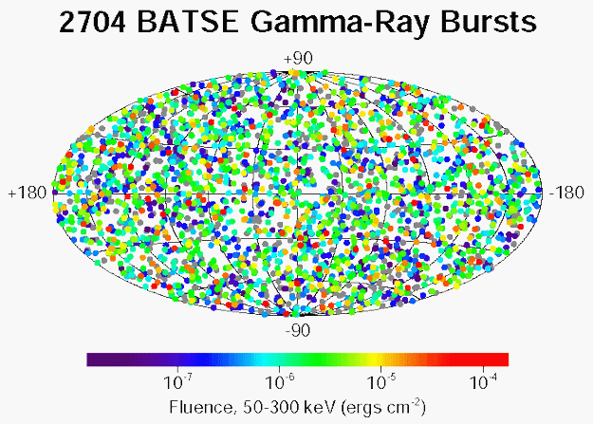
Distribution of GRBs on the sky
Cosmological

Slide 5
Burst Duration & classification
B u r s t
The burst duration is BIOMODAL and can be divided into two subgroups
Long------ T₉₀ ≥ 2 sec. (~75%)
Short----- T₉₀ ≤ 2 sec. (~25%)
T₉₀ → The time in which 90% of the burst energy is observed
Long and Short have different origins !

Slide 6
Till 2018 non were observed in
VHE (≥100 GeV)
Observation of Gamma Ray Bursts (GRBs) in very high energy (VHE > 100 GeV)
GRBs are predicted to be the sources of VHE gamma-rays. But………..

Slide 7
Several dozen GRBs in few GeV range have been detected by
The Energetic Gamma Ray Experiment Telescope (EGRET above 100 MeV) and Fermi-LAT in the past had multiple attempts to detect very high energy (VHE) gamma-rays (>100 GeV) from GRBs, all were unsuccessful.
In the years 2018 and 2019 VHE photons were detected from GRB 180720B by Major Atmospheric Gamma Imaging Cherenkov Telescope (MAGIC) and GRB 190114C by The High Energy Stereoscopic System (HESS), opening a new window in the electromagnetic spectrum for the study of GRBs.
Observation of sub-TeV photons from the afterglow phase would provide crucial information regarding the particle acceleration and radiation mechanisms, leptonic and hadronic contributions to the luminosity and other microphysical parameters in GRB physics.
It has been argued that high-energy gamma-rays above 100 MeV are produced via synchrotron mechanism in the afterglow shocks.
But it is hard to explain the sub-TeV photons detected at late times (>100 s) as the shock is already decelerated substancially.

Slide 8
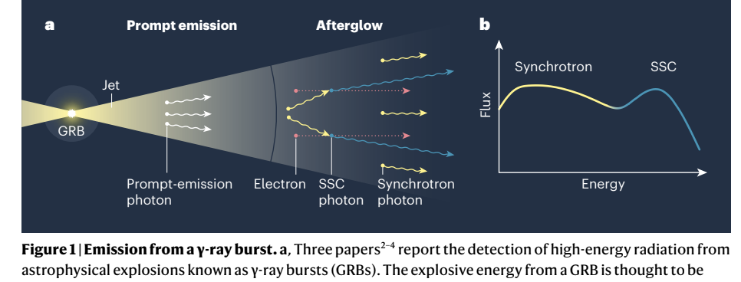
Formation of BH, Hypernova,
Ultra-relativistic jets
GRB 190114C ,
GRB 180720B.
MAGIC Collaboration. Nature 575, 455–458 (2019).
MAGIC Collaboration et al. Nature 575, 459–463 (2019).
Abdalla, H. et al. Nature 575, 464–467 (2019).
GRB 190114C and GRB 180720B.
Nature: News & Views, Bing Zhang, 575, 448 (2019)

Slide 9
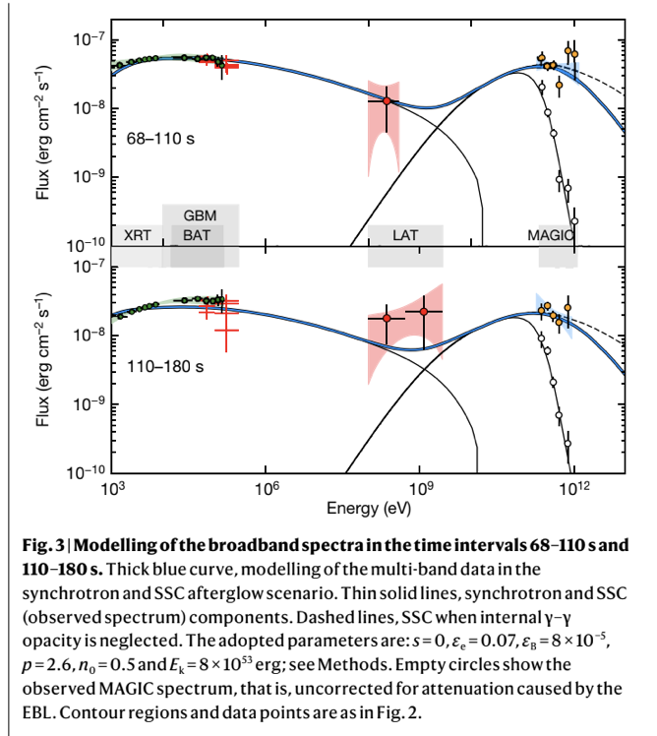
GRB190114C, z=0.4245
MAGIC
T0+578 s ---- T0+15912 s (4.42h)
0.2 TeV ⩽ E ⩽ 0.9 TeV
Nature 575, 456 (2019)

Slide 10
What are the most used models to explein these VHE gamma-ray events ?
Synchrotron self-Compton (SSC) process (many parameters)
Proton synchrotron process (Large magnetic field and large proton energy)
Proton-proton collision process (background proton)
Photohadronic process (compact photon background)

Slide 11
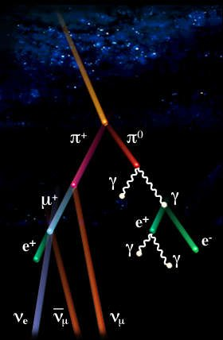
Photohadronic Model (Sahu et al.)
We have developed a photohadronic model which can explain the multi-TeV flaring from high energy blazars
The Fermi accelerated high energy protons interact with the background photons in the jet environment to produce △-Resonance.

Slide 12
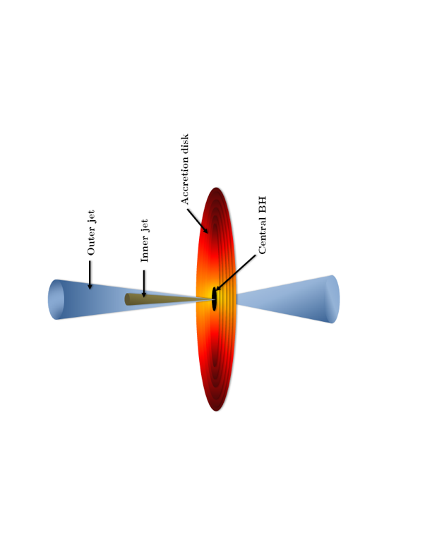
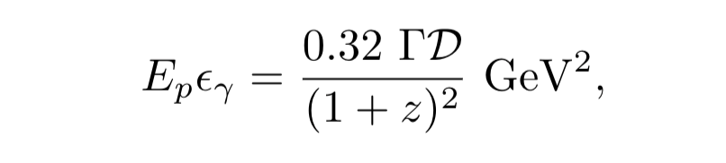
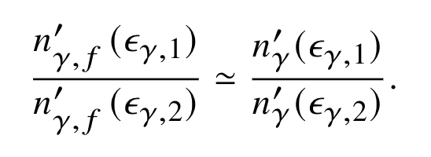
Jet structure during flaring (Originally for HBLs)
Photohadronic scenario
To produce pions through Δ-resonance
What we assume ……
Photon density in the inner region >> outer region during a flaring.
In comoving frame each π carries ~0.2 (20%) of the proton energy.

Slide 13
Kinematical Condition
$E_{γ}ε_{γ}$=0.032 $Γ δ {(1+z)}^{−2} {GeV}^{2}$
Each π carries ~0.2 of the proton energy
Each ν carries ¼ of pion energy
Each γ carries ½ of pion energy.

Slide 14
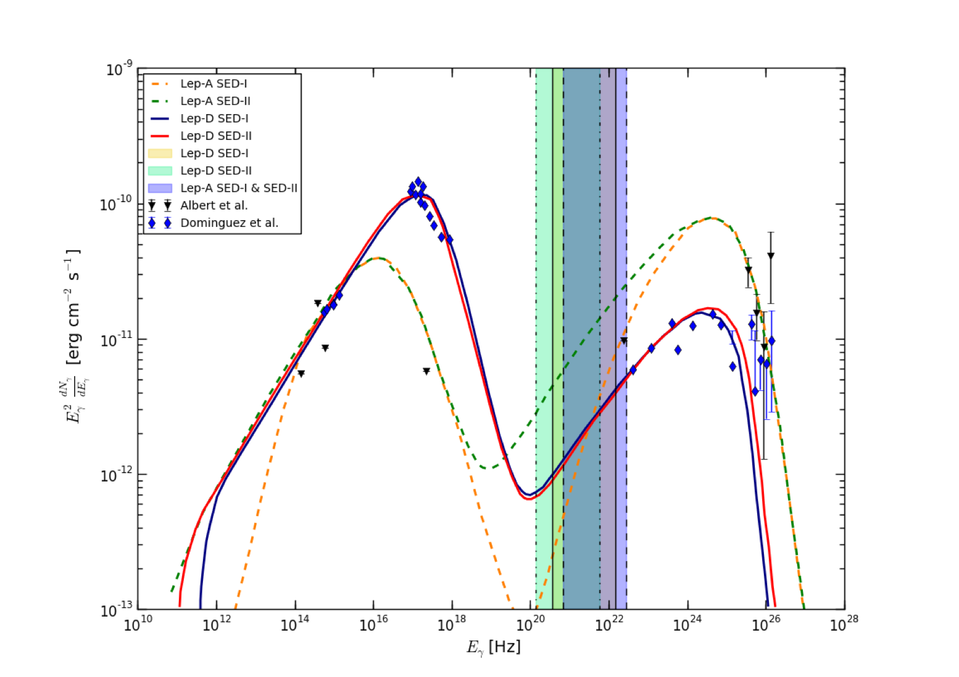
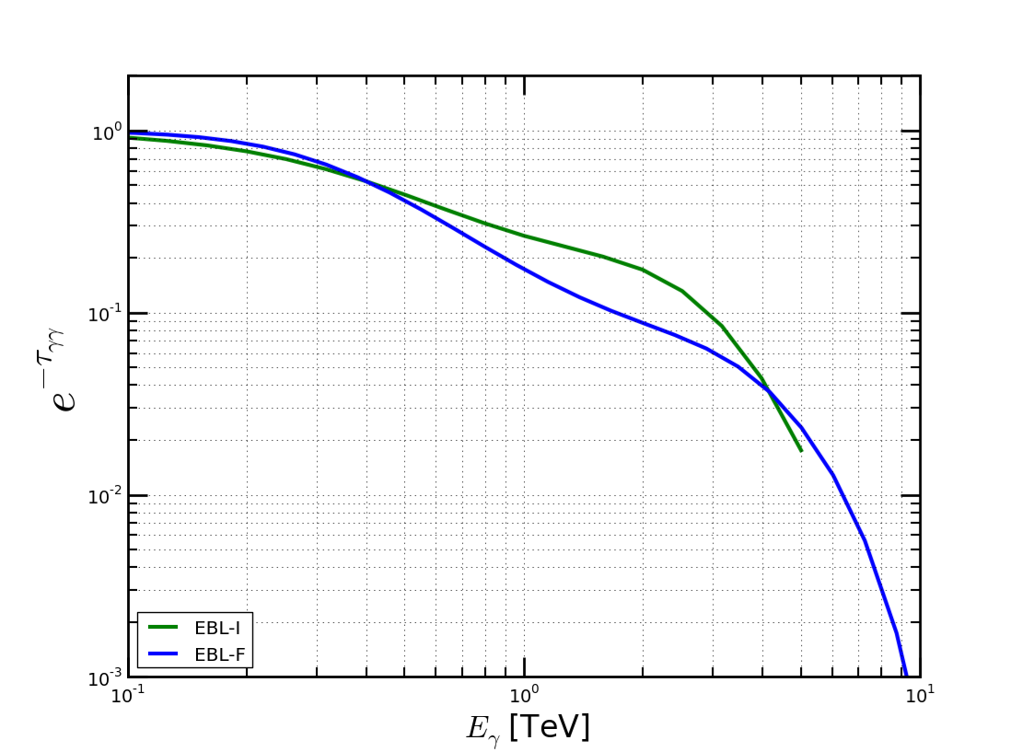
Leptonic Model:

Slide 15
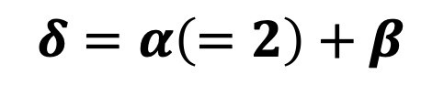
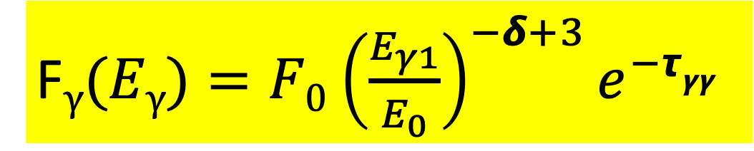
The γ-ray flux due to pion decay will be
Finally
TeV photon and the HE protons are related through
Neutrino
F$γ(Eγ)=F0$ ${\left(\frac{E_{γ1}}{E_{0}}\right)}^{−δ+3}e^{−τγγ}$
$$δ=α\left(=2\right)+β$$
20%
2/3 prob.

Slide 16
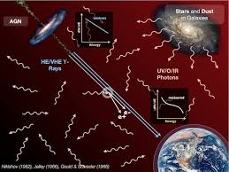
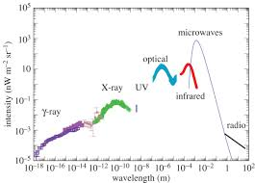
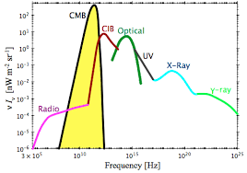
Extragalactic Background Light (EBL)
0.1-100 𝞵m wavelength range emitted by stars, galaxies, from nucleosynthesis in AGN, reprocessed by dust.
This diffuse background is called EBL

Slide 17
$F_{γ,obs}$($E_{γ}$)=$F_{γ,in}$($E_{γ}$)$e^{−τ_{γγ}(E_{γ,}z)}$

Slide 18
Classification scheme of the flaring states of high energy blazars (HBLs):
Sahu et al. ApJL 884, L17 (2019)
Low emission state
High emission state
Very high emission state
2.5 ≤𝞭 ≤ 2.6
𝞭 =3.0
2.6 < 𝞭 < 3.0

Slide 19
Similarity between Blazar and GRB
The GRB afterglows have the same radiation mechanism as the BL Lac objects.
A similar correlation of the synchrotron luminosity and Doppler factor between GRBs and AGNs.
Relativistic jets in AGNs and GRBs have a similar energy dissipation efficiency.
Despite order of magnitude differences in their masses and bulk Lorentz factors, the jets in GRBs and blazars have many characteristics in common.
We study the VHE emission mechanisms in the afterglow phases of GRBs by using the common mechanisms and processes that are being used to study the multi-TeV flaring of high energy blazars.

Slide 20
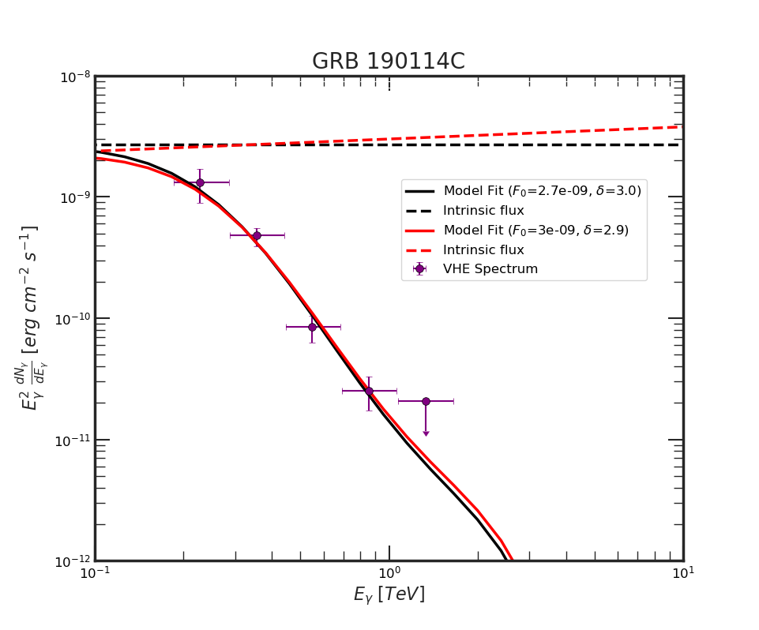
Spectra of Observed GRBs in VHE 𝛄-rays:
ApJL 895, L41 (2020)
Sahu and Carlos
Proton interacting with the SSC photons

Slide 21
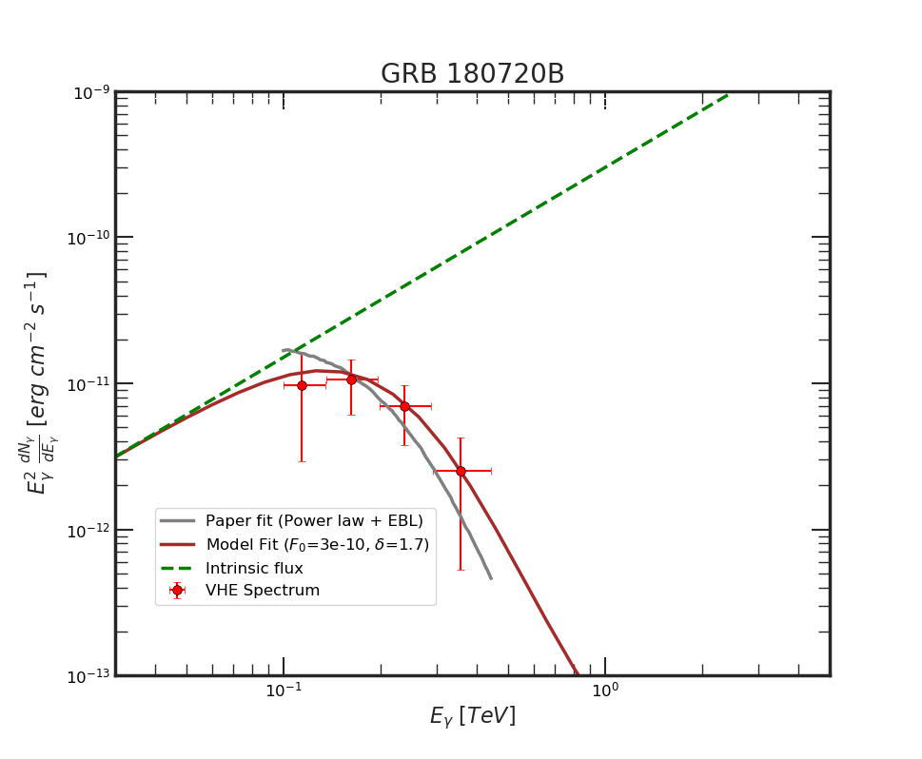
Nature 575, 464 (2019)
ApJL 895, L41 (2020)
Sahu and Carlos
Proton interacting with the synchroton photons

Slide 22
GRB 190829A observed by HESS, Science 372, 1081 (2021)
Proton interacting with the SSC photons in the forward shock region
Sahu et al, ApJ 929, 70 (2022)

Slide 23
GRB 221009A

Slide 24
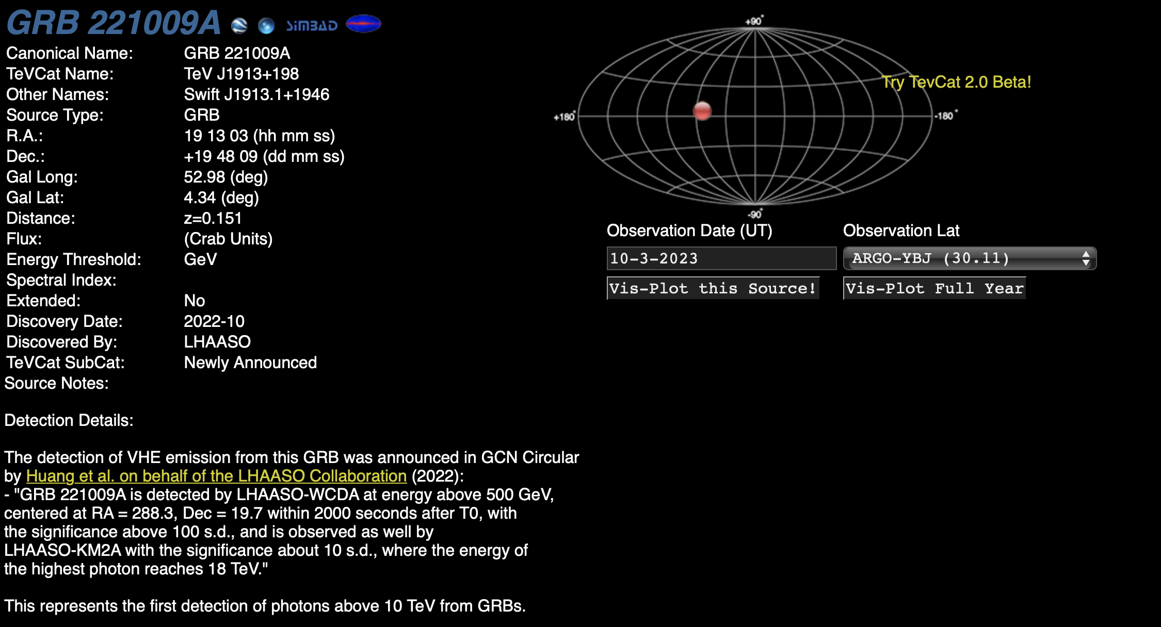

Slide 25
Observation
On October 9, 2022, at T0 = 13 : 16 : 59.000 UT, a long duration gamma-ray burst (GRB), identified as GRB 221009A (also known as Swift J1913.1+1946) was detected in the direction of the constellation Sagitta by the Gamma-ray Burst Monitor (GBM) onboard the Fermi Gamma-ray Space Telescope.
The prompt emission was also detected by several other space observatories, such as the Fermi Large Area Telescope (LAT), Swift, AGILE, INTEGRAL, Solar Orbiter, SRG, Konus, GRBAlpha and STPSat-6.
The Fermi-LAT detected the most energetic photon of energy 99.3 GeV (at t_0+240 s).

Slide 26
It is the highest energy photon ever detected by Fermi-LAT from a GRB in the prompt phase.
The afterglow emission was also observed at different wavelengths and the optical follow-up observation estimated a very low redshift of z= 0.151.
The total emitted isotropic-equivalent gamma-ray energy from GRB 221009A is estimated to be 1.2e+55 erg.
This is the brightest, long-duration GRB, and arguably, one of the nearest, and possibly, the most energetic GRB ever observed.
It has also been reported that GRB 221009A produced a significant ionization of the Earth's lower ionosphere (~ 60-100 km and is the strongest ionization effect ever recorded from a GRB).

Slide 27
The Large High Altitude Air Shower Observatory (LHAASO), Tibet, China with the water Cherenkov detector array (WCDA) and the larger air shower kilometer square area (KM2A) detector observed more than 5000 very high energy (VHE) photons within T0+2000 s in the 500 GeV to 18 TeV energy range, making them the most energetic photons ever observed from a GRB.
Surprisingly, the ground-based Cherenkov detector Carpet-2 at Baksan Neutrino Observatory reported the detection of undoubtedly a very rare air-shower originating from a 251 TeV photon 4536 s after the GBM trigger from the direction of the GRB 221009A.
Observations of these unusually VHE gamma-rays by LHAASO and Carpet-2 from GRB 221009A are incomprehensible, and led to the speculations of non-standard physics explanations of these observed events.

Slide 28
However, there is a caveat concerning the observation of 251 TeV gamma-ray.
The angular resolution of the Carpet-2 is several degrees and the two previously reported Galactic VHE sources, 3HWC J1928+178 and LHASSO J1929+1745, are located close to the position of the GRB 221009A.
It remains uncertain whether the observed 251 TeV photon is from the GRB 221009A or from either of these Galactic sources.
In the present context, we try to explain the VHE emission observed by LHAASO (~18 TeV photons) using the photohadronic model.

Slide 29
Reffred to as Brightest of All Time (BOAT)
Has the highest isotropic-equivalent total energy ever identified ~1e+55 erg
Such type of GRB is estimated to be one in every 10,000 years (rarest event !!!!)
arXiv:2302.14037

Slide 30
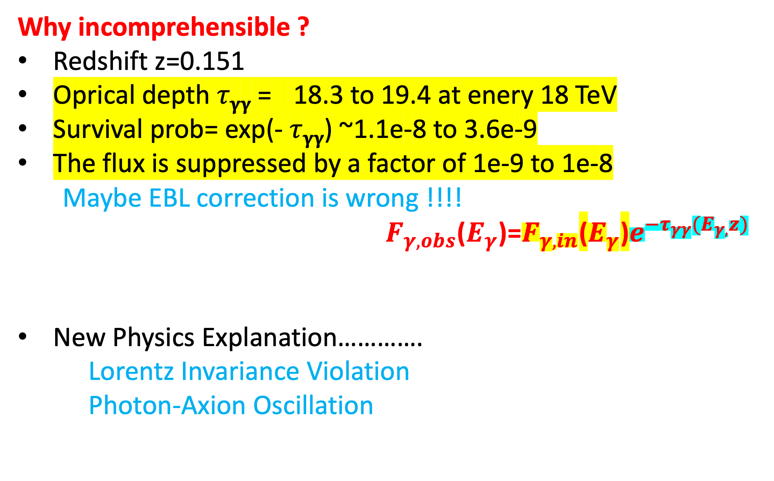
Why incomprehensible ?
Redshift z=0.151
Oprical depth 𝜏_{𝛄𝛄} = 18.3 to 19.4 at enery 18 TeV
Survival prob= exp(- 𝜏_{𝛄𝛄}) ~1.1e-8 to 3.6e-9
The flux is suppressed by a factor of 1e-9 to 1e-8
Maybe EBL correction is wrong !!!!
${ F}_{γ,obs}$($E_{γ}$)=$F_{γ,in}$($E_{γ}$)$e^{−τ_{γγ}(E_{γ,}z)}$
New Physics Explanation………….
Lorentz Invariance Violation
Photon-Axion Oscillation
Detection of such energetic photons is unexpected due to the large opcity of the Universe

Slide 31
It is possible that in the afterglow epoch the intrinsic very high energy photon flux from the source might have increased manifolds, which could compensate the attenuation by pair-production with the extragalactic background light.
We propose such a scenario and show that very high energy photons can be observed on the Earth from the interaction of very high energy protons with the seed synchrotron photons in the external forward shock region of the GRB jet.

Slide 32


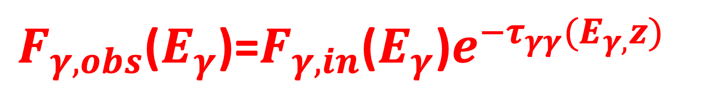
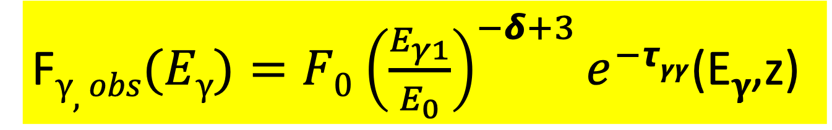
Increase this
F$γ,obs(Eγ)=F0$ ${\left(\frac{E_{γ1}}{E_{0}}\right)}^{−δ+3}e^{−τγγ}$(E_{𝛄},z)
$F_{γ,obs}$($E_{γ}$)=$F_{γ,in}$($E_{γ}$)$e^{−τ_{γγ}(E_{γ,}z)}$
$τ_{γγ}$ is the optical depth which depends on both energy and the redshift of the object.

Slide 33
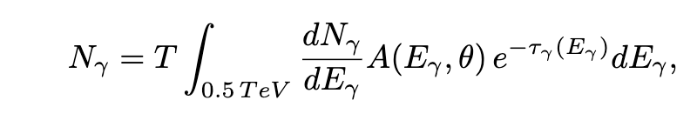
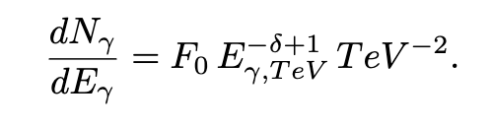
No of photons observed during the time T (2000 s) by the detector is > 5000 LHAASO- WCDA and KM2A
Fix the value of N_{𝜸} (5500) and fix 𝞭, then calculate F₀
Use this F₀ to calculate the Flux
He have done this for different values of 𝞭 and N_{𝜸}

Slide 34
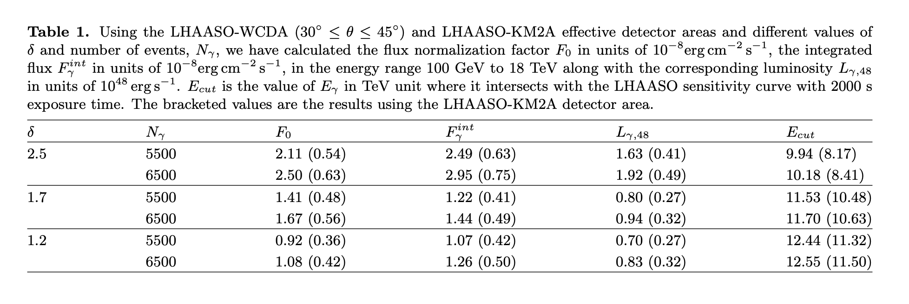

Slide 35
Relative energy resolution of WCDA around 18 TeV ±50%
LHAASO-WCDA
Synchrotron photon
SSC photon
18 TeV

Slide 36
LHAASO-KM2A
Relative energy resolution of KM2A around 18 TeV ±36%
LHAASO-KM2A

Slide 37
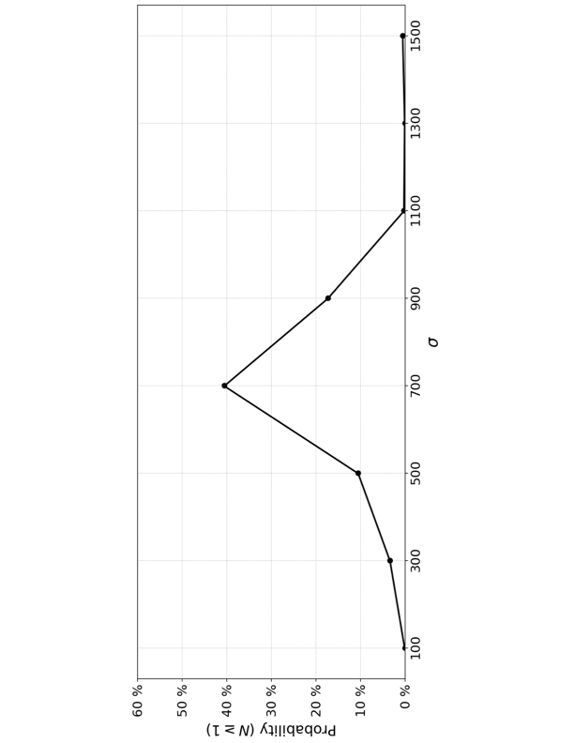
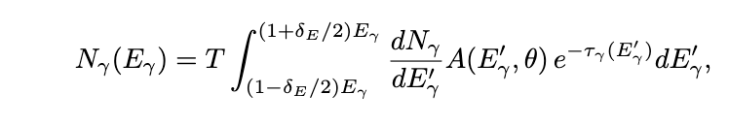
Chance probability of observing a photon of energy ⩾ 18 TeV (LHAASO-WCDA)

Slide 38

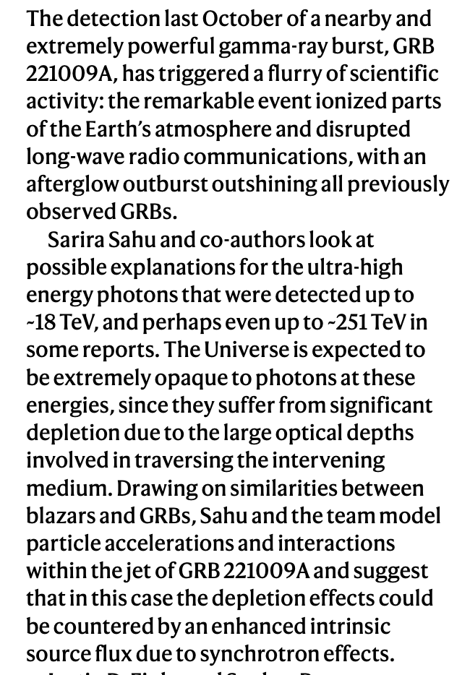
Nature Astronomy 7, 124 (2023), 14 Feb 2023

Slide 39
Summary
The recent observation of ~18 TeV photons by LHAASO from GRB 221009A sheds doubt on the applicability of the well-known EBL models for photons of energy > 10 TeV at a redshift of 0.151 even though these EBL models work very well in explaining the VHE spectra of so many other TeV sources.
This incompatibility has led towards new physics solutions.
Lorentz Violation, Photon-Axion coupling (oscillation).

Slide 40
However, there is still a conventional way to deal with the problem, which we proposed here.
We argue that high energy protons interacting with the synchrotron photon background in the GRB jet will be able to produce photons of energy close to 18 TeV.
Our analysis shows that LHAASO-WCDA is more likely to observe photons of energy ~ 18 TeV than the LHAASO-KM2A.
We anticipate that the publication of GRB 221009A results (VHE Spectrum) should be able to shed light on these interpretations.

Slide 41
Thank You

